Slide 1
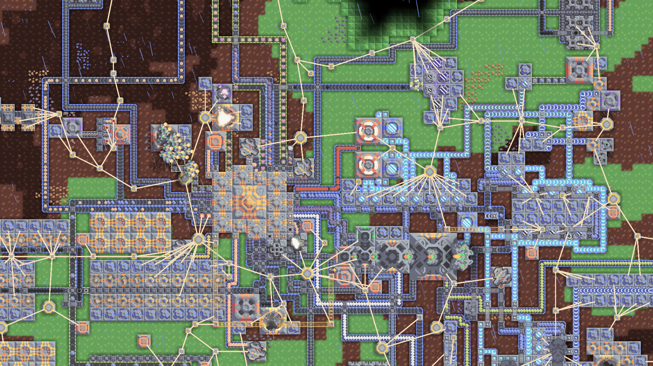


Slide 2
Sprint 1

Slide 3
Backlog
Student ID
Story
To Do
Doing
Review
Done
US1: Como jogador do mindustry sinto falta de níveis de eficiência nas máquinas. Assim que as adquirimos não existe forma de serem melhoradas. Se existisse esta opção o jogo seria mais desafiante e completo.
66565
67196
US2: Como jogador do jogo, gostaria de ter avisos mais chamativos quando o conveyor não tem destino, fica bloqueado ou está mal montado, para que eu possa manter informação em tempo real do estado do jogo.
67215
68509
US3:Como um jogador veterano, gostaria de construir uma nova defesa que desativa as capacidades aéreas destas unidades, para que eu possa lidar com elas numa maneira estratégica, forçando-as a lutar no chão.
68663
70116

Slide 4
Backlog
Student ID
Story
To Do
Doing
Review
Done
US1: [...]
US1: [...]
T1: [...]
Student #1
US2: [...]
Student #2
US1: [...]
T2: [...]
Student #3
Student #4
Student #5
Student #6

Slide 5
Backlog
Student ID
Story
To Do
Doing
Review
Done
US1: [...]
US1: [...]
T1: [...]
Student #1
US2: [...]
Student #2
US1: [...]
T2: [...]
Student #3
Student #4
Student #5
Student #6

Slide 6
Backlog
Student ID
Story
To Do
Doing
Review
Done
US1: [...]
US1: [...]
T1: [...]
Student #1
US2: [...]
Student #2
US1: [...]
T2: [...]
Student #3
Student #4
Student #5
Student #6

Slide 7
Backlog
Student ID
Story
To Do
Doing
Review
Done
US1: [...]
US1: [...]
T1: [...]
Student #1
US2: [...]
Student #2
US1: [...]
T2: [...]
Student #3
Student #4
Student #5
Student #6

Slide 8
Sprint 2

Slide 9
Backlog
Student ID
Story
To Do
Doing
Review
Done
Code Smells report
Explore codebase
Recognize present code smells
66565
67196
Use case diagram
67215
68509
68663
70116

Slide 10
Backlog
Student ID
Story
To Do
Doing
Review
Done
Recognize present code smells
Explore codebase
66565
Code Smells report
Recognize present code smells
Explore codebase
67196
Explore codebase
Recognize present code smells
67215
Recognize present code smells
Explore codebase
68509
Use case diagram
Recognize present code smells
Explore codebase
68663
Recognize present code smells
Explore codebase
70116

Slide 11
Backlog
Student ID
Story
To Do
Doing
Review
Done
Recognize present code smells
Explore codebase
66565
Code Smells report
Explore codebase
Recognize present code smells
67196
Explore codebase
Recognize present code smells
67215
Explore codebase
Recognize present code smells
68509
Use case diagram
Recognize present code smells
Explore codebase
68663
Recognize present code smells
Explore codebase
70116

